Slide 1

Missing Persons in the USA

Slide 2
What’s the Deal with Missing Persons???
Over 99% of missing persons are found or return home within 48 hours.
A person remains on the missing persons file until they are found dead or alive.
The missing persons file has information into 2018, but we limited it through 2017.

Slide 3
<Line Graph of Missing Persons By Gender and Year of Disappearance>

Slide 4
Data Munging
Import csv files for missing persons data and population data.
Combine, transform, parse and map data into formats for specific analyses.
Identified null values to be removed
Removed unnecessary columns
Limited some data to 1990 forward due to 15 million rows of datat
Schema developed in postgres for further filtering.
Flask app created to render html and sql api.
Choropleth colors were pre-computed rather than numbers being used for each state for each year to speed up the data updates

Slide 5
< Bar Chart of Missing Persons by Gender >

Slide 6
<Bar Chart of missing persons by race>

Slide 7
<Bar chart of missing persons by age group.>

Slide 8
Challenges
Learning to load fwf file with no heading
Population data had numbers representing values, such as 1 = Male, 2= Female…making the data difficult to analyze, and for this reason we had to replace the numerical values with the true value. We assume this was done to reduce space.
Flask errors that resulted from null values called by improper sql joins.
Census data changing formats and information during the study period, resulting in limited probability comparisons.
Different files using different descriptors for the same item (e.g. Native American vs. Native Indian)
Radar Chart (Chartjs library) loading library issues – needed npm or bower to install. Pip nor conda installs worked.
Choropleth map of missing number per states was giving correct results for all but 2 states; we were never able to figure out why the fill colors were skipped for these 2 states (TN and VA).

Slide 9


Slide 10
Missing Persons by State
The following are samples of choropleths available for decades ending each year from 1977 through 2017.
Based on rate of missing persons per population
The colors range from red to blue,
Red being over 10 times the national average rate.
Blue is less than 30% of the national average rate.
A logarithmic scale was used, since Alaska would have dominated any linear scale.
Alaska is the biggest outlier
The less populated western areas tend to have higher rates
Arizona has been steadily rising in missing persons

Slide 11
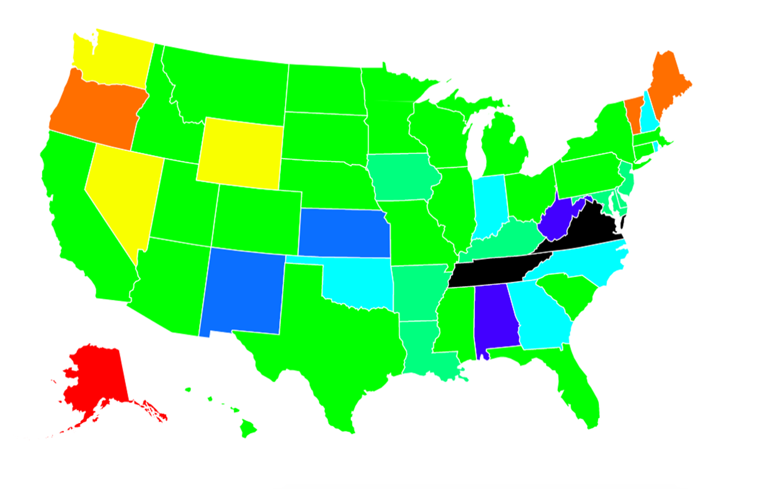
Missing Persons Rate - Decade Ending 1977

Slide 12
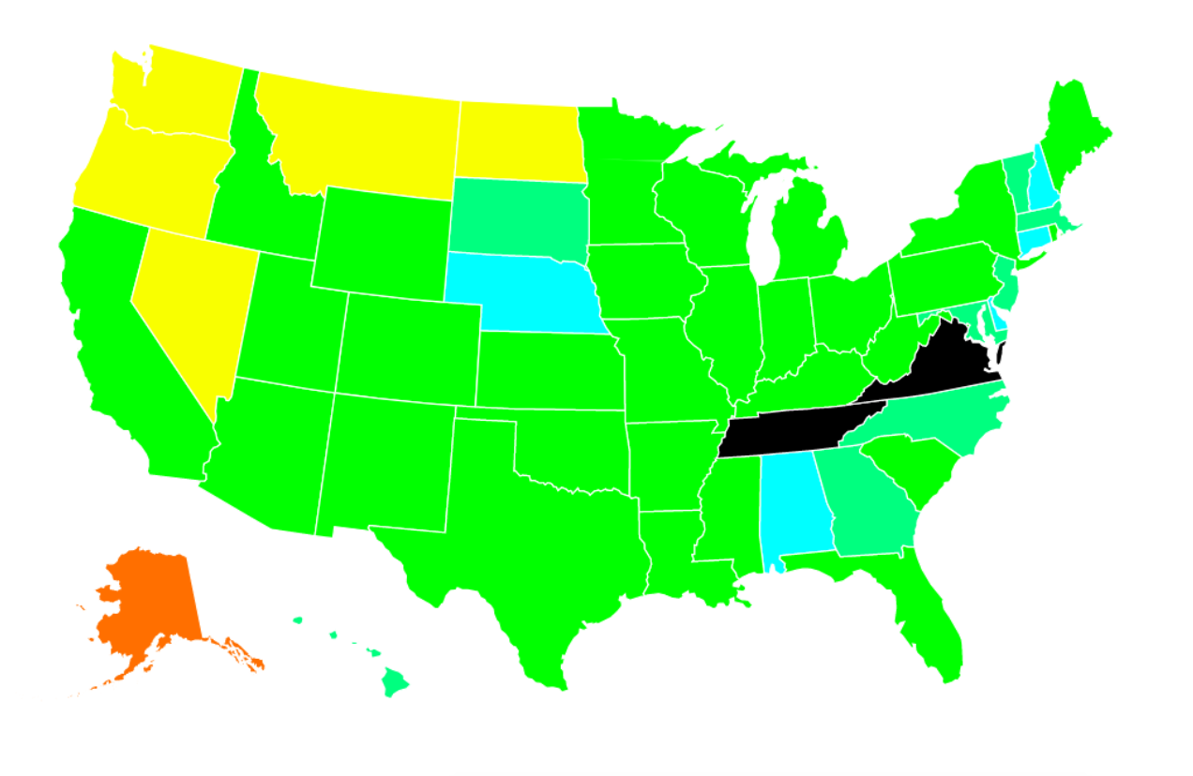
Missing Persons Rate - Decade Ending 1997

Slide 13
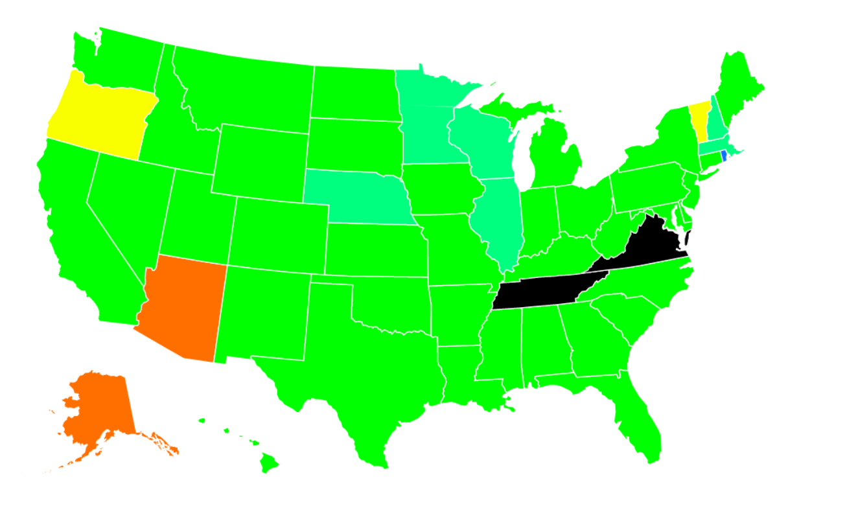
Missing Persons Rate - Decade Ending 2017

